Slide 1
Telco customer analytics
By Vinh Vu

Slide 2
Business problem:
Through this project, I want to identify the root causes for customer churn and predict it by machine learning.
Client:
My client, Telco Company, is a telephone and internet service provider with over 5000 customers. In order to grow and maintain profitability, it’s essential that they learn how to maintain a dedicated customer base and reduce churn. Based on my analysis, Telco can:
Identify customers that are likely to churn and reach out to them to try to stop them from churning via special offers targeted to their needs
Focus marketing on customers that are more likely to be long term customers
Modify their services to improve the likelihood customers will stay longer term

Slide 3
Data collection and wrangling summary
I am going to use Telco Customer Churn dataset which is provided by Kaggle. I will use the panda library to import csv file.

Slide 4
Constructing the Data
Connect tables
Convert columns with yes/ no to 0/1
Use get_dummy turning a column to multiple column
Clean data and check for missing values.

Slide 5
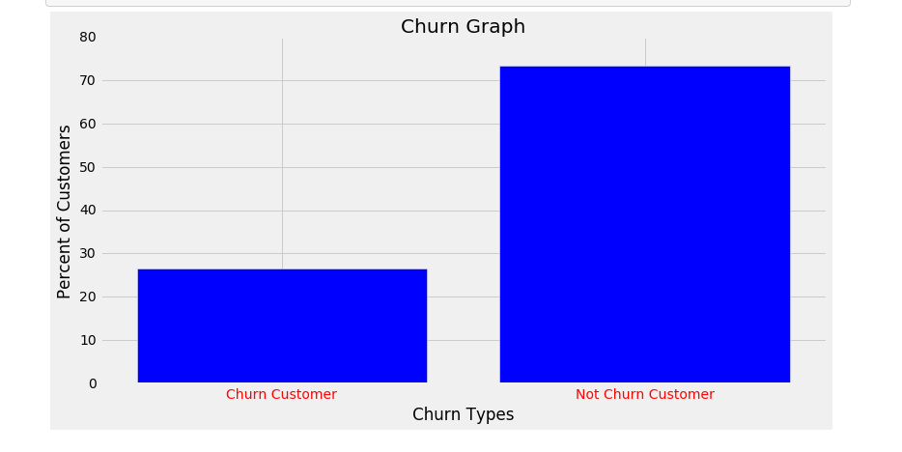
Exploring the Data (Data storytelling)

Slide 6
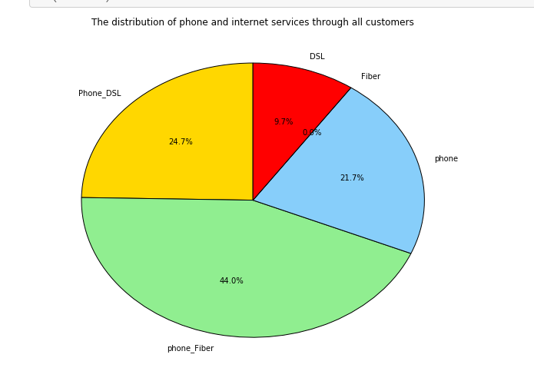

Slide 7
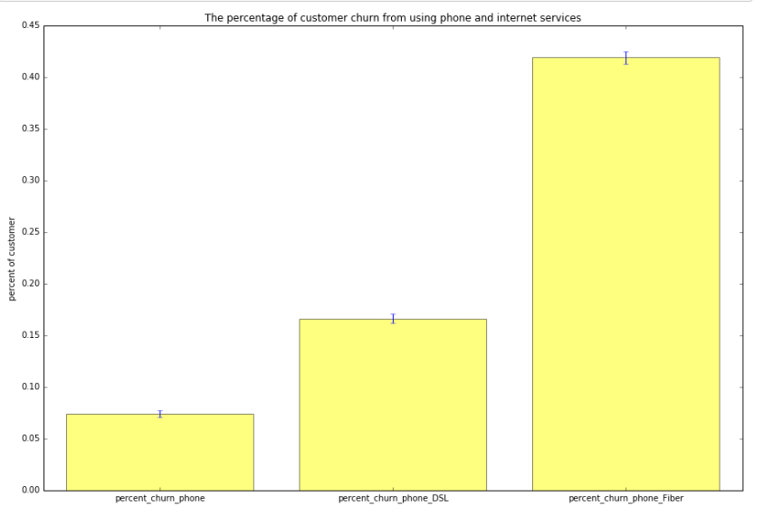

Slide 8
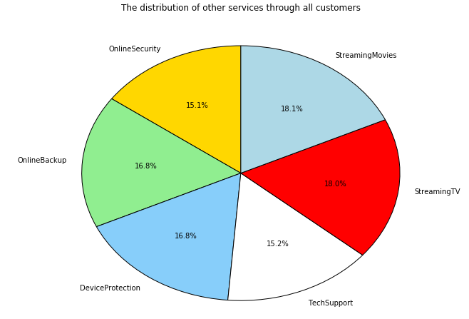

Slide 9
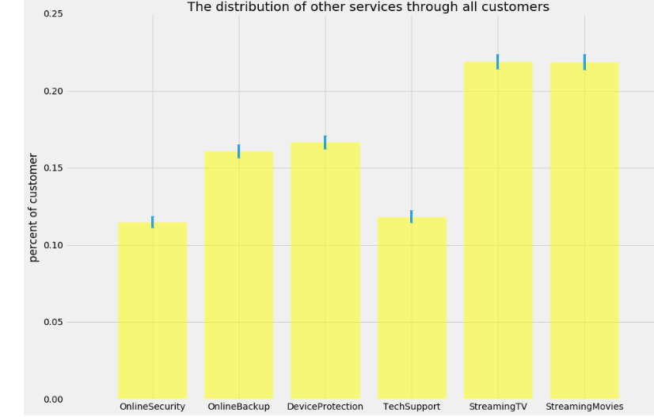

Slide 10
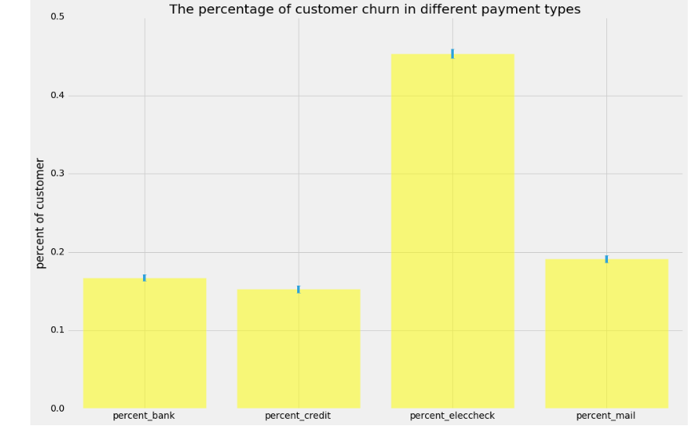

Slide 11
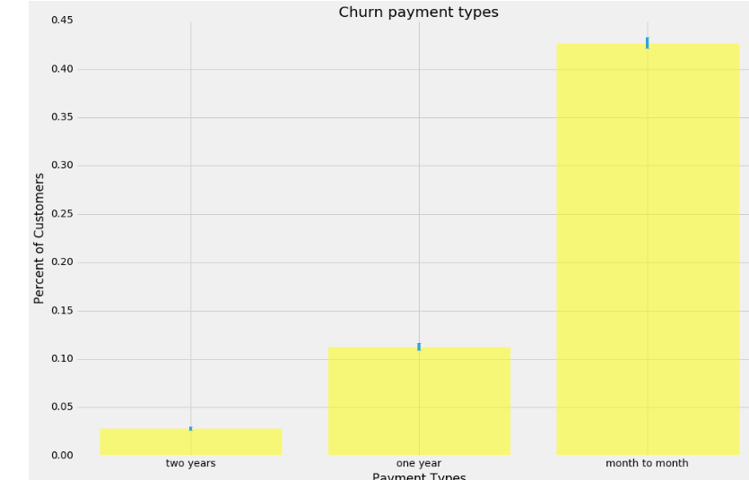

Slide 12
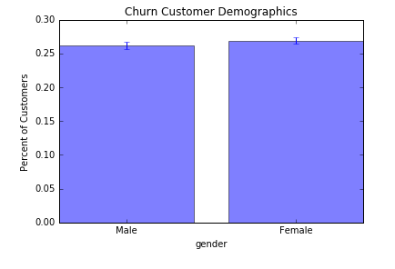
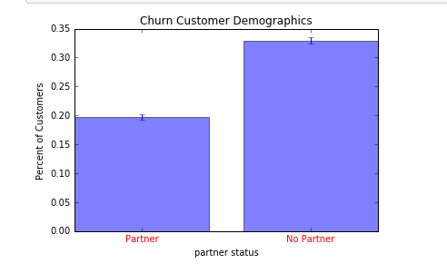
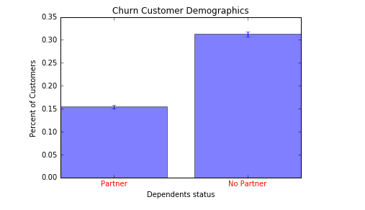

Slide 13
Inferential Statistics
One sample test:
The One Sample T-Test determines whether the sample mean is statistically different from a known or hypothesized population mean.
· Null Hypothesis: there is no difference in tenure between churn customers and the customer population.
· Alternate Hypothesis: there is a significant difference in tenure between churn customers
Ttest_1sampResult(statistic=-31.856572712421674, pvalue=3.0614037111362083e-178)
The t-distribution left quartile range is: -1.96123406594
The t-distribution right quartile range is: 1.96123406594
(17.093332889308954, 18.86493356333952)

Slide 14
Two Sample test:
---Gender:
Null hypothesis: there is no different between male and female in customer churn.
Hypothesis: there is a different between male and female in customer churn.
Ttest_indResult(statistic=-0.72261049878576156, pvalue=0.46994323541735661)
P value<0.05 , so null hypothesis is rejected

Slide 15
Two Sample test:
---Gender:
Null hypothesis: there is no different between male and female in customer churn.
Hypothesis: there is a different between male and female in customer churn.
Ttest_indResult(statistic=-0.72261049878576156, pvalue=0.46994323541735661)
P value<0.05 , so null hypothesis is rejected

Slide 16
Two Sample test:
---Dependent status:
Null hypothesis: there is no different between dependent and no dependent in customer churn.
Hypothesis: there is a different between dependent and no dependent in customer churn.
Ttest_indResult(statistic=-15.409078802902004, pvalue=2.1775286391572522e-52)
P value<0.05 , so null hypothesis is rejected

Slide 17
Two Sample test:
---Partner status:
Null hypothesis: there is no different between partner and no partner in customer churn.
Hypothesis: there is a different between partner and no partner in customer churn.
Ttest_indResult(statistic=-12.841725043203832, pvalue=2.529114349220257e-37)
P value<0.05 , so null hypothesis is rejected

Slide 18
Two Sample test:
---senior discount:
Null hypothesis: there is no different between senior and no senior in customer churn.
Hypothesis: there is a different between senior and no senior in customer churn.
Ttest_indResult(statistic=11.580732091336619, pvalue=9.3643915616853527e-30)
P value<0.05 , so null hypothesis is rejected

Slide 19
Results and In-depth analysis using machine learning
For this project, we use four model such as Decision Tree Model, AdaBoost Model, Logistic Regression Model, and Random Forest Model

Slide 20
Base rate model
Base rate generally refers to the (base) class probabilities unconditioned on evidence, frequently also known as prior probability. A Base Rate Model is a model that always selects the majority class which compares to other models. In this project, we compare Churn =0 where are customers who don’t churn.
In churn vs not churn customer graph, the percentage of churn customer is 28.5% total customer, and the percentage of non-churn customer is 71.5% total customer. The base rate model would predict every non churn customers and ignore churn customers.
Example: The base rate accuracy for this data set, when classifying everything as 0's, would be 71.5% because 71.5% of the dataset are labeled as 0's (not churn customer).

Slide 21
Class Imbalance
Due to skewed distribution of customers who churn and don’t churn, the data set is an imbalanced problem. Imbalanced data typically refers to a problem with classification problems where the classes are not represented equally. In this case, the conventional model evaluation methods do not accurately measure model performance when faced with imbalanced datasets. We has to know the different errors and concepts.
In this type of evaluation: False Positive and False Negative errors.
False Positives (Type I Error): You predict that the customers will churn, but do not
False Negatives (Type II Error): You predict that the customers will not churn, but does churn
In this problem, what type of errors do we care about more? False Positives or False Negatives?

Slide 22
Different Ways to Evaluate Classification Models:
Decision tree models allow you to develop classification systems that predict or classify future observations based on a set of decision rules
AdaBoost Model: AdaBoost can be used to boost the performance of any machine learning algorithm. It is best used with weak learners. These are models that achieve accuracy just above random chance on a classification problem..
Logistic Regression Model: Logistic regression is used to describe data and to explain the relationship between one dependent binary variable and one or more nominal, ordinal, interval or ratio-level independent variables.
Random Forest Model: Random Forest grows many classification trees. To classify a new object from an input vector, put the input vector down each of the trees in the forest. Each tree gives a classification, and we say the tree "votes" for that class. The forest chooses the classification having the most votes (over all the trees in the forest)

Slide 23
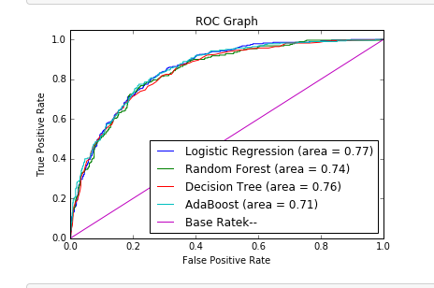

Slide 24
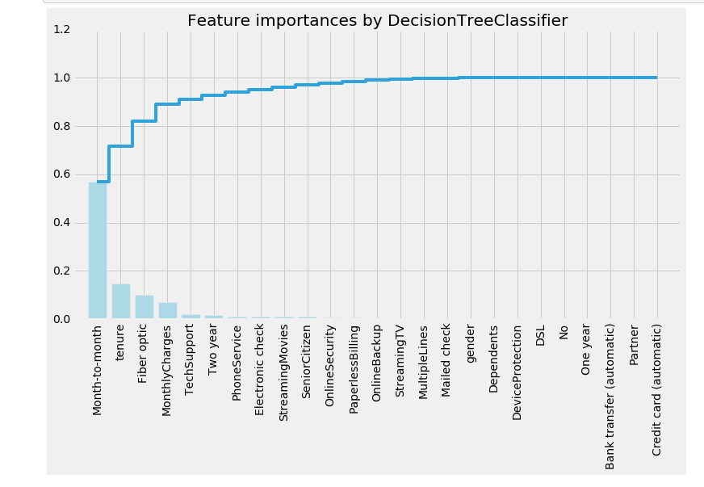

Slide 25
Interpreting the Data
Summary: With all of this information, this is what we know why customers probably churn:
Customer generally left when they are month to month payment type.
Customer is likely to churn in first ten months.
Customers is likely to leave customer when they use Fiber optic service.
But there is 0% customers use fiber only, customers are likely to cancel services when they use phone and fiber.
Customers have no partner and no dependent is highly percentage to churn than other.
Customer month to month, tenure, and fiber optic were the three biggest factors in determining churn.

Slide 26
Potential Solution
For this problem, we should look at the probability that customer will leave the company rather than the prediction whether customer left within certain time frame. We can rank the probably of leaving for employees, we can have any deals or discount to keep them.
Consider customer churn where a customer is given deal or discount by Telco because telco think the customer will leave the company within a month, but the employee actually does not. This is a false positive. This mistake could be expensive and time consuming for both telco and customers, but is a good investment for relational growth.
Compare this with the opposite error, where Telco does not give deal to the customers and they do leave. This is a false negative. This type of error is more unfavorable because the company lost an customer, which could lead to lose money.
Depending on these errors, different deal are weighed based on the type of customer. For example, customer has multiple service purchased, on time payment which is good customer (potential growing) vs customer has one service purchased, not on time payment which is not good customer(better to lose this customer than saved ).

